Slide 1

“HUMAN PERSONALITY PREDICTION BASED ON BEHAVIOURAL FACTORS”
ADNAN BAIG

Slide 2
About me
Name :- ADNAN BAIG
Batch :- Ai Elite-16
Qualification :- Bachelors Of Engineering (Mech Engg)
Why Data Science:- While studying mechanical engineering, I developed a strong foundation in problem-solving, critical thinking, and analytical skills.
I saw it as a chance to expand my skillset beyond traditional engineering and gain proficiency in cutting-edge technologies like artificial intelligence and machine learning. This transition presents an exciting opportunity to contribute to innovative projects and be at the forefront of technological advancements.
After graduation , Pursuing a course in data science allowing me to leverage data-driven methodologies to solve complex problems, derive decision to solve business problems, innovate, and contribute effectively in today's data-centric world.
LinkdIn :- 🔗📌 click here
GitHub :- 🔗📌 click here

Slide 3
Machine Learning Project Description
Titles | Description
Project Title | Human Personality Prediction
Project Domain | Human Psychological and Behavioral Analysis
Type of Machine Learning | Supervised Machine Learning
Type of Problem | Classification Problem
Project Methodology | CRISP ML-Q Methodology
Project Deployment | Streamlit

Slide 4
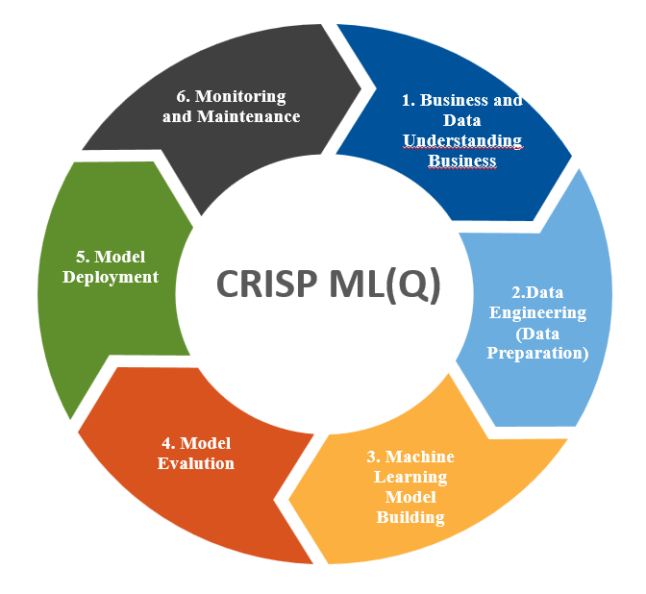
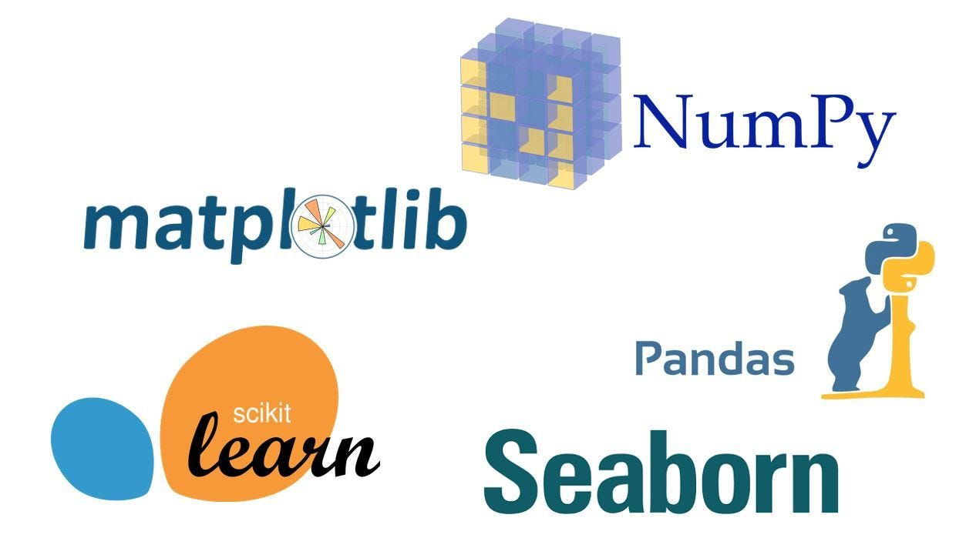
Workflow based on CRISP ML-Q methodology
Business problem understanding
Data collection and understanding
Data Preparation
Exploratory data analysis
Data cleaning
Feature Engineering
Machine leaning model building
Machine learning model evaluation
Machine learning model deployment using streamlit
Monitoring and Maintenance

Slide 5
Business Problem
1. Understanding Consumer Behavior :- Many businesses aim to understand their customers better to tailor their products or services accordingly. Predicting personality traits can provide valuable insights into consumer behavior, enabling companies to create more targeted marketing campaigns, design personalized products, and improve customer satisfaction.
2. Employee Recruitment and Management: Human resource departments often struggle to identify the best candidates for job roles based solely on resumes and interviews. By predicting personality traits from behavioral data, companies can streamline the recruitment process, matching candidates with roles that align with their personalities, work styles, and preferences.
3. Psychological Research and Analysis:- Psychologists and researchers are constantly seeking ways to better understand human behavior and personality. Machine learning models predicting personality traits can assist in large-scale psychological studies, providing insights into how various factors influence personality development and behavior across different populations.
Objectives
The primary objective of this project is to develop a machine learning model that can accurately predict human personality traits based on various behavioral factors, and demographic information. The model should be able to classify individuals into one of the five major personality traits extraverted, serious, responsible, lively, and dependable.
Constraints
1. Data Availability and Quality
2. Scalability

Slide 6
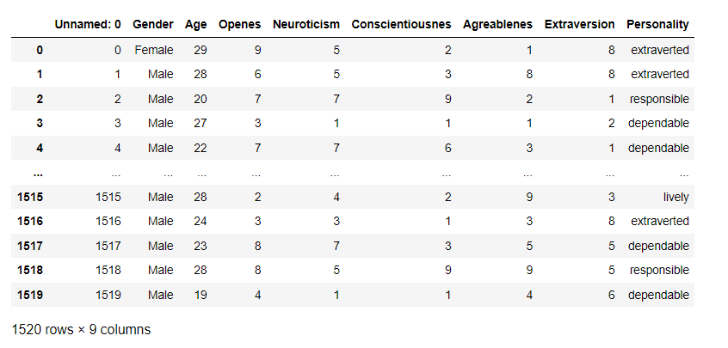
Summary Of the Data and Understanding
Data understanding for the dataset involves closer examination of its attributes and statistical properties of this attributes and their potential implications for data science project. This section is delved into understanding of aspects like attributes, statistical summarization, potential preprocessing steps and insights derive from the analysis.

Slide 7
Dataset’s Features Description
I have collected data from powerful data collection source known as Kaggle. Dataset contains 1520 records and 9 features.
Features involved:-
Gender:- Gender Feature specify the information about gender of person which representing Male or Female.
Age:- Age feature representing age of particular person , Age ranging from 18-35.
Openness:- Openness is one of the big five personality traits. It represents a person's willingness to try new things, their curiosity, and their creativity.
Neuroticism:- Neuroticism reflects the tendency to experience negative emotions such as anxiety, depression, and irritability.
Conscientiousness:- Conscientiousness is a personality trait characterized by being organized, responsible, and goal-oriented. It reflects the degree of self-discipline and impulse control.
Agreeableness:- Agreeableness is a personality trait that reflects how friendly, compassionate, and cooperative an individual is. It indicates the tendency to be trusting and empathetic towards others.
Extraversion:- Extraversion is a personality trait characterized by outgoingness, assertiveness, and sociability. Extraverted individuals tend to seek out social interactions and enjoy being the center of attention.
Personality (Target):- This is the target variable we have to predict. The labels traits are extraverted, serious, responsible, lively, and dependable. The model will be trained to predict the personality traits based on the features provided.

Slide 8
Data Preparation
Exploratory data analysis:-
Sr. No | Type | Feature Names | Observation
1 | Missing Values | NA | The dataset carefully examine and found to contain no missing values. These completeness ensure accurate and reliable analysis.
2 | Duplicates | NA | The dataset reveals no instances of duplicates records. Its reliability for analytical purpose.
3 | Outliers | All features | It has been identified, Outliers is not exist in each feature.
4 | Distributions | Histogram used for Age, Openness, Neuroticism, Conscientiousness, Agreeableness, Extraversion | Analysis reveals near about all features following Normally distribution
5 | Distributions | Bar plot for Gender and Target Variable. | This Bar plot help me to identify there is 51% Male and 40% Female
6 | Relationships | Between input and input features | Scatter Plot reveals that inputs feature is not doing any relationship between them.

Slide 9
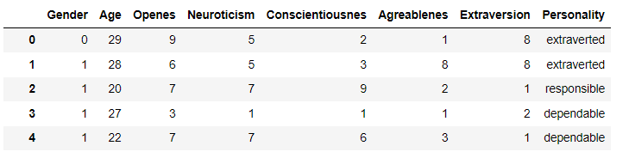
b) Data Cleaning
Data cleaning involves crucial steps for better analysis and accurately performing machine learning model. Data cleaning contains missing values treatment, outliers treatment, duplicates record treatment , normalization, scaling, encoding etc. In this case, I found some treatment that should be done, I have performed encoding for categorical data, other than this I did not find any other steps that should be done.
In Gender column there was Categorical data so I performed encoding and encoded Male as 0, Female as 1.
c) Feature Engineering:
I have performed different feature engineering techniques such as variance score, variance threshold so it reveals there is all feature are important for prediction excepts one .There was only one feature that is not useful for analysis, I dropped that feature 'Unnamed: 0‘,
After Data preprocessing dataset looks like:-

Slide 10
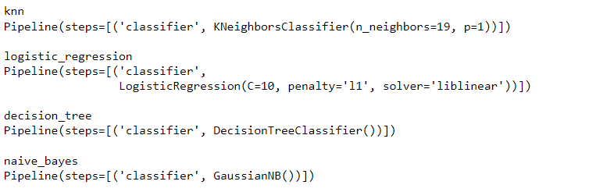
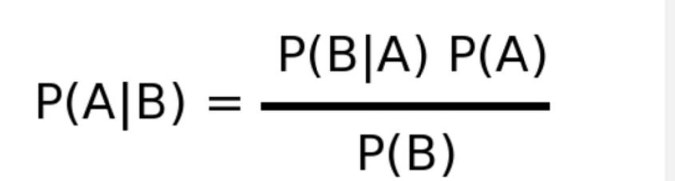
Machine Learning Model Building
Selection of machine learning algorithm is crucial and confusing task, based on my problem statement my data was normally distributed and target is categorical variable, so I have used Gaussian Naive Bayes Algorithm, also I developed pipeline and in that pipeline I served different algorithm and based on their performance I selected best performing algorithm so in that Gaussian Naïve Bayes Algorithm was best and accurate performing algorithm.
I split the data into X as inputs ans Y as Output and then split inputs and output into train and test after splitting looks as X_train , X_test , y_train , y_test. Because splitting the data is important thing to build machine learning model.
After splitting I trained my model using X_train and y_train.
Gaussian Naive Bayes:- It is came from supervised machine learning , It follow the probability based approach, In training phase It captures the marginal and joint probability using frequency table.
It calculate the probability by multiplying the probability of each and classify based on higher probability.

Slide 11
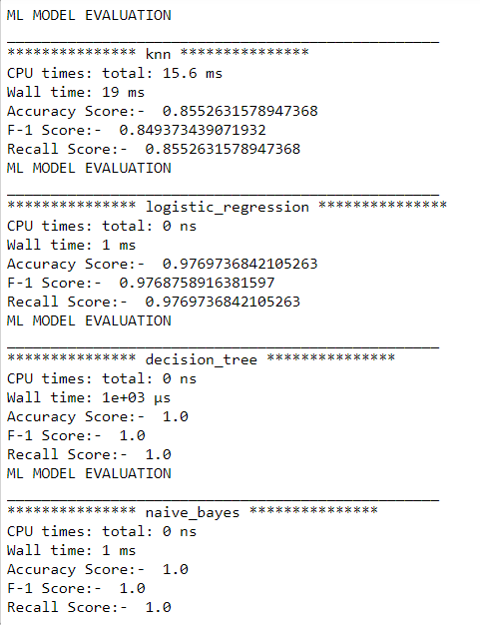
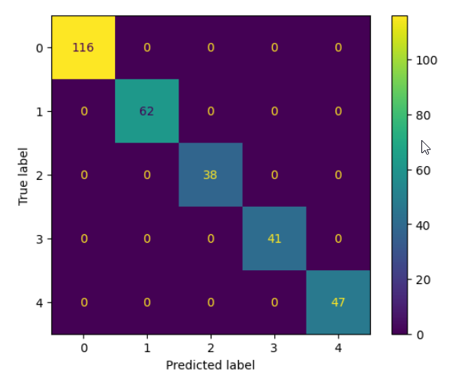
Machine Learning Model Evaluation
In machine learning model evaluation, I used different evaluation matrix such as Accuracy score, F-1 score, Confusion matrix. Accuracy shows how often model is predicting accurately and Confusion matrix shows how much it predicted correctly as well as incorrectly.
We can see in image Naïve Bayes is best performer as per accuracy
with 100% and executing times as compare to other algorithm.
Confusion Matrix:-

Slide 12
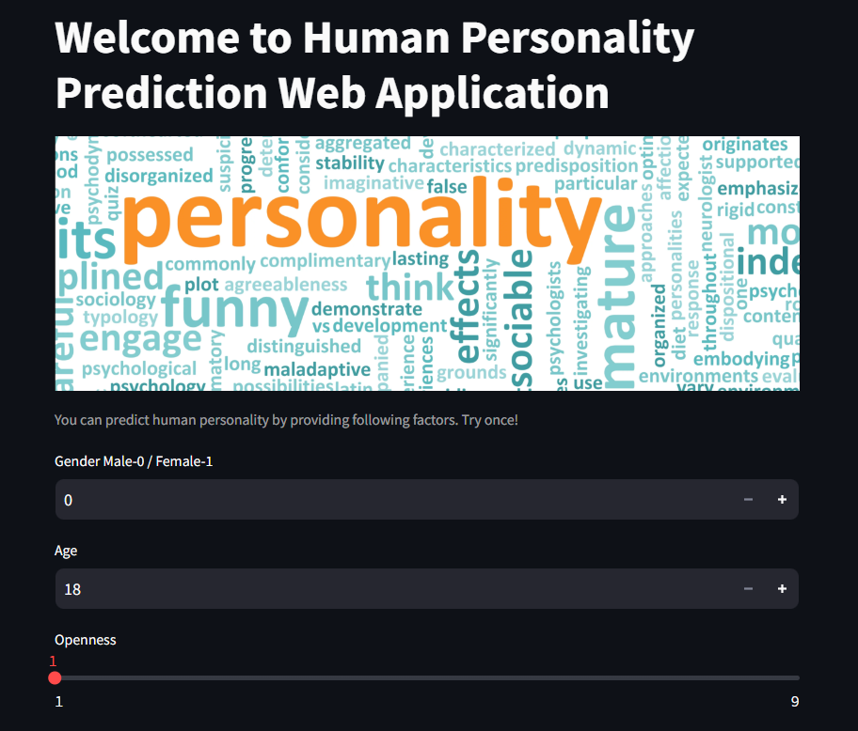
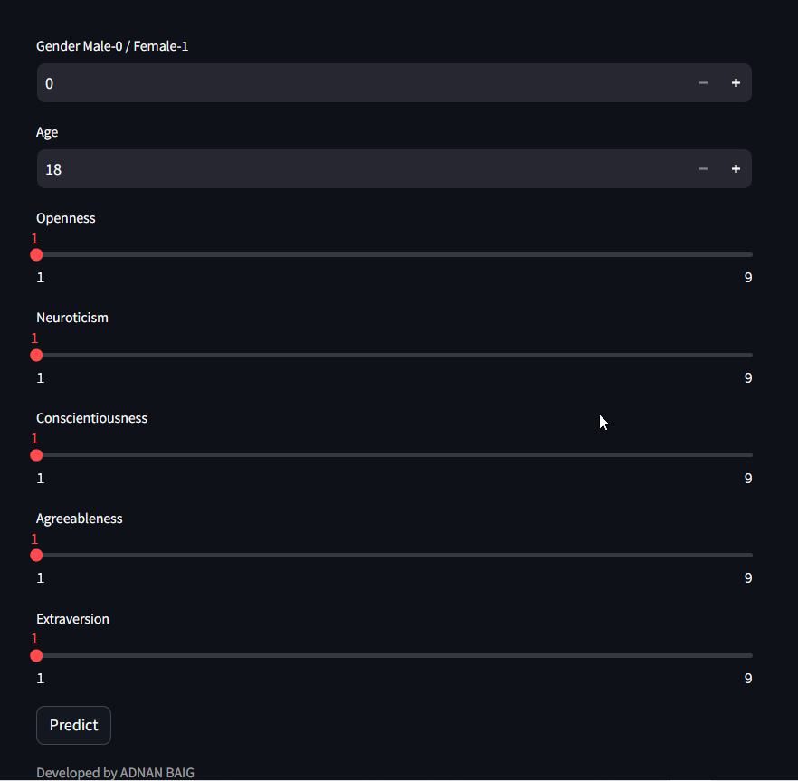

Machine Learning Model Deployment
From images you can see web application is working fine and It is capable of taking inputs from users and prediction of personality bases on inputs. Prediction such as “Dependable, Lively, Extraverted, Serious, and Responsible”.

Slide 13
Application of Personality Prediction Web Application
This web application can be used to identify the right candidate based on his personality and behavior in any organization for work handling.
The another use of this web application is it can be used to match marital profiles, to identify behavior of opponents.
This web application can be use in business to target the customers based on their behavior
Advantages
Insight into Human Behavior: By predicting personality traits, we can gain valuable insights into human behavior, preferences, and tendencies. This knowledge can be useful in various fields such as psychology, marketing, human resources, and healthcare.
Personalized Services: Personality prediction can enable personalized services and recommendations tailored to individual preferences and traits. For example, personalized product recommendations, job recommendations, or educational resources.
Disadvantages
Ethical Concerns: Predicting personality raises ethical concerns related to privacy, consent of personal information.

Slide 14
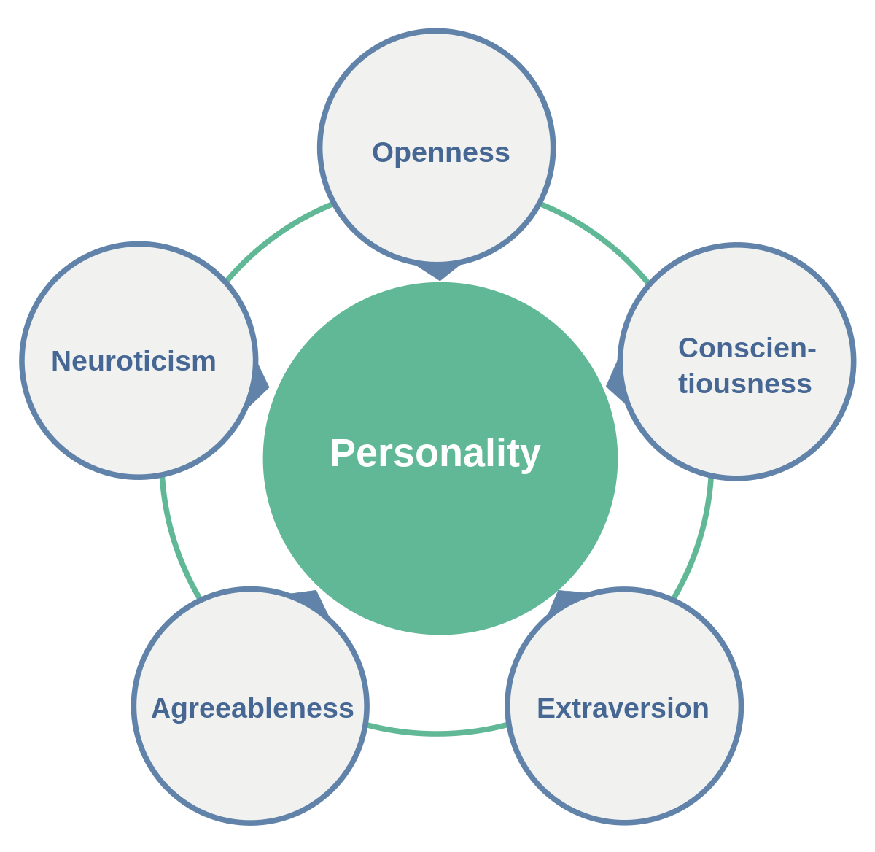
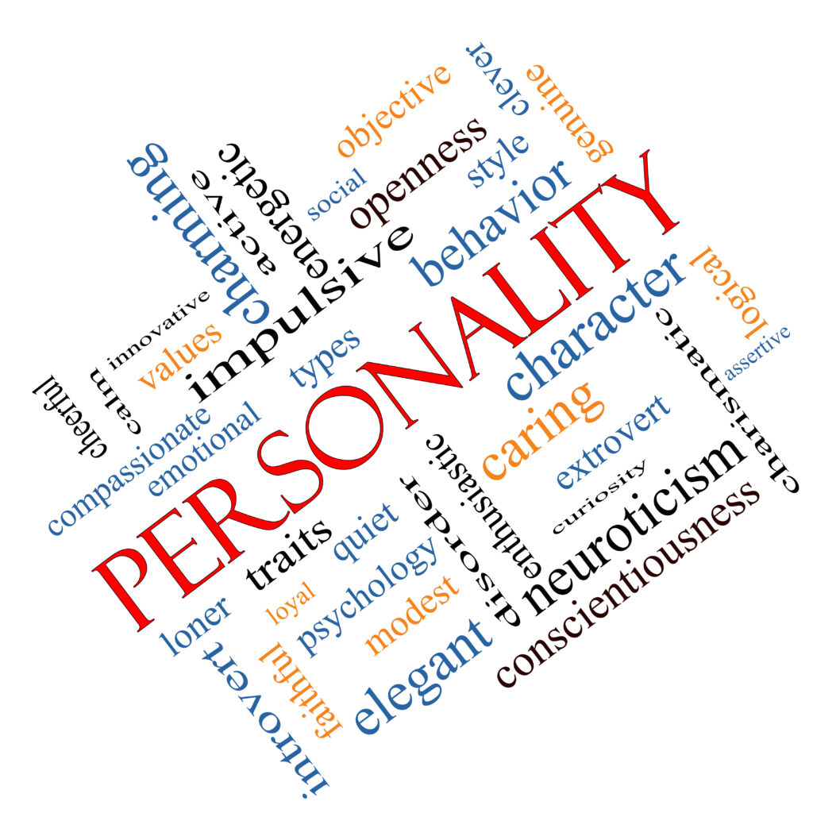
Conclusion
In conclusion, journey through the analysis and model development of personality dataset with naive bayes has been insightful and productive. I understand the problem statements, and I collect the data and understand that data to perform better analysis and prepare the data perform necessary data cleaning steps.
In modeling I chosen Naive Bayes Algorithm based on its performance over others, Evaluate the machine learning model based on different evaluation matrix. I chosen that model that are predicting perfect with correctly predictions, after this I successfully deploy my web application using streamlit platform, so user can use that application and predict anyone’s personality based on behavior traits.
The project offers valuable insights into human behavior, enabling personalized services, improved user experiences and advancements in psychology and behavioral sciences.

Slide 15

THANK YOU

